Slide 1
India Socio Economic Data Analysis
Data Science project
By:
ANKUR KUMAR

Slide 2
CONTENT
Problem Statement
Dataset Overview
Data Profiling
Questions
Conclusion
Future Work
References

Slide 3
Problem Statement
India Socio Economic Data Analysis provides an overall socio economic perspective of India at depth of District & State Level.
What are the socioeconomic trends in different parts of India?

Slide 4
DATASET OVERVIEW
India States GDP & GR data (1999-2005) at District level.(gdp_{stateName}.csv)
India Elementary data having details of population, education data at District Level.(elementary_2015_16.csv)
India Cencus Housing data having details of Area, Asset , resource data at District Level.(india_census_housing-hlpca-full.csv)
India Cencus data having details of population, worker , power parity data at District Level.(india-districts-census-2011.csv)

Slide 5
DATA PROFILING
Making one dataset for all District GDP and other for all District GR.
Merging the Indian elementary data with cencus-housing data, required mandatory change in District name to match both dataset.
Merging with Cencus dataset and replacing the NA value.
Making one dataset having GDP,Elementary,housing and Cencus Data.

Slide 6
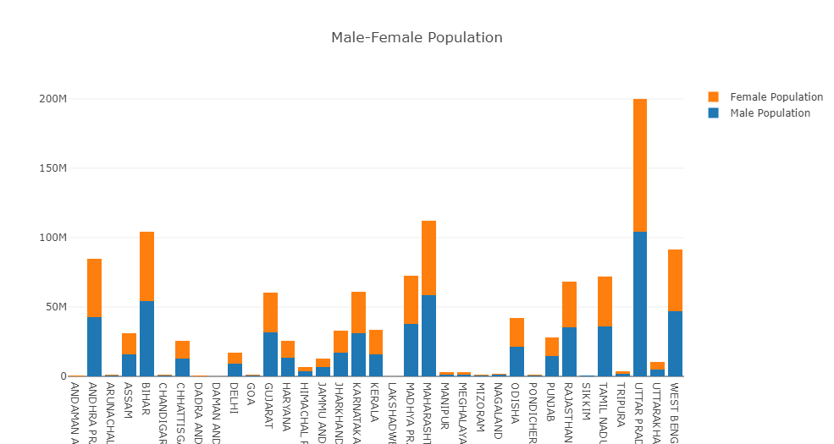
Questions 1. State wise male and female population in India
smaller_gr_sc_st

Slide 7
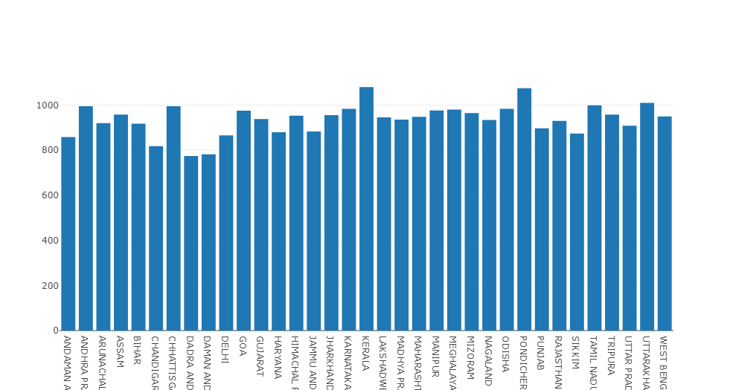
2. Sex ratio of females per 1000 males in Indian states

Slide 8
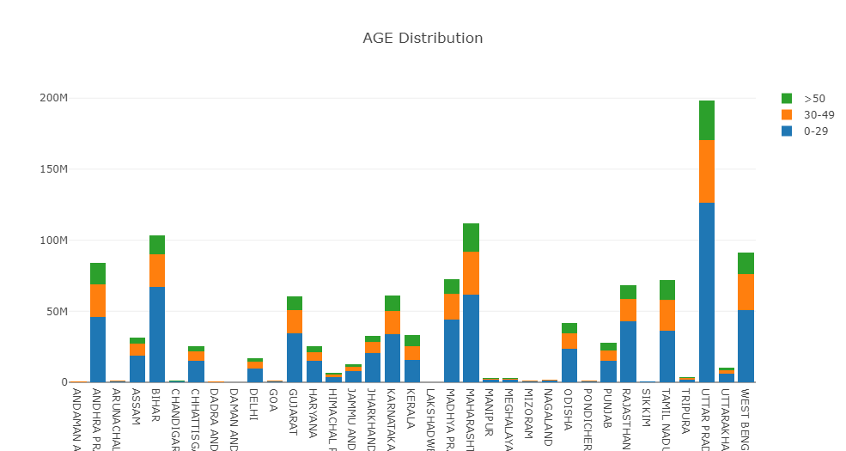
3. Population of different types of age groups in India

Slide 9
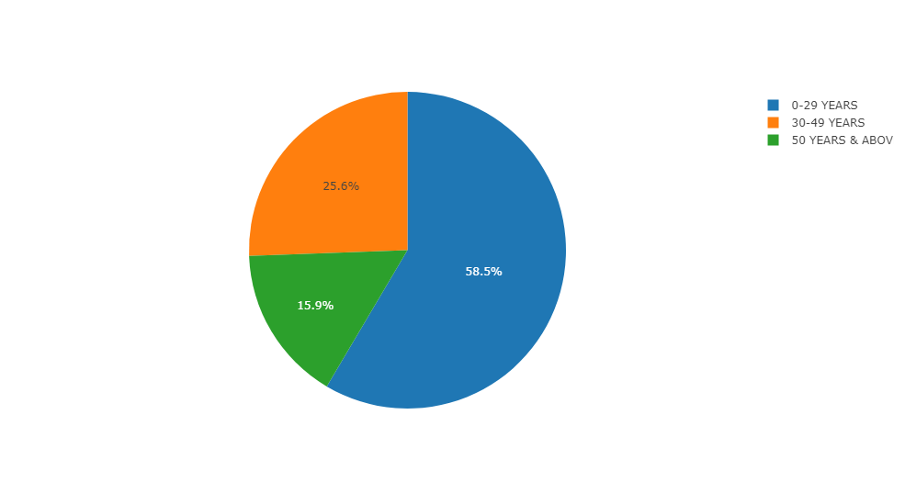
4. Different age group percentage in India

Slide 10
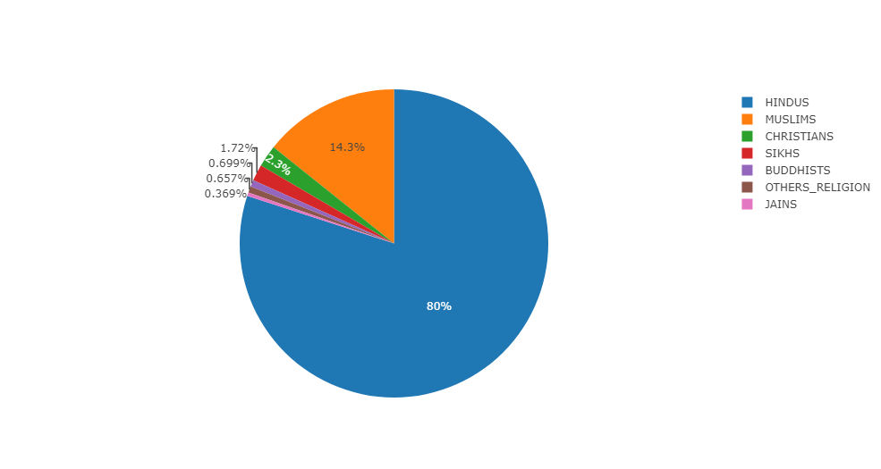
5.(i) Religion's distribution in India

Slide 11
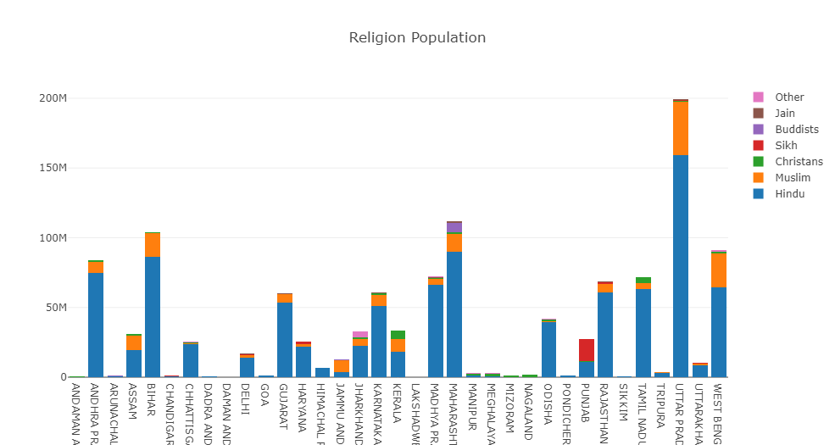
5 (ii). Religion's distribution in India

Slide 12
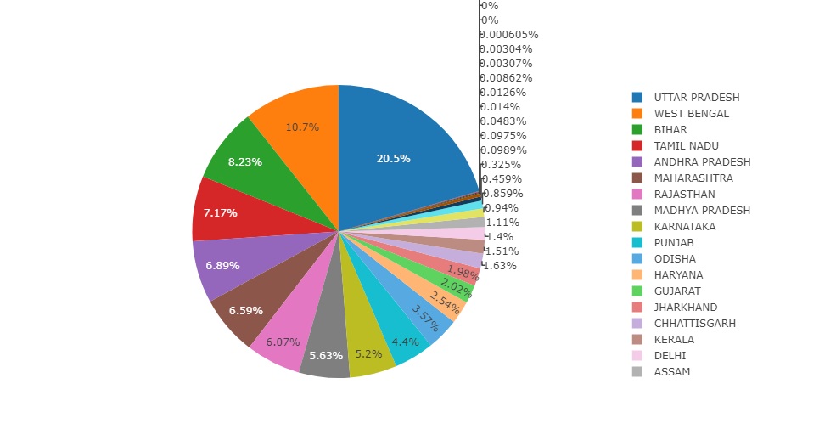
6.(i) State wise SC populations percentage in India

Slide 13
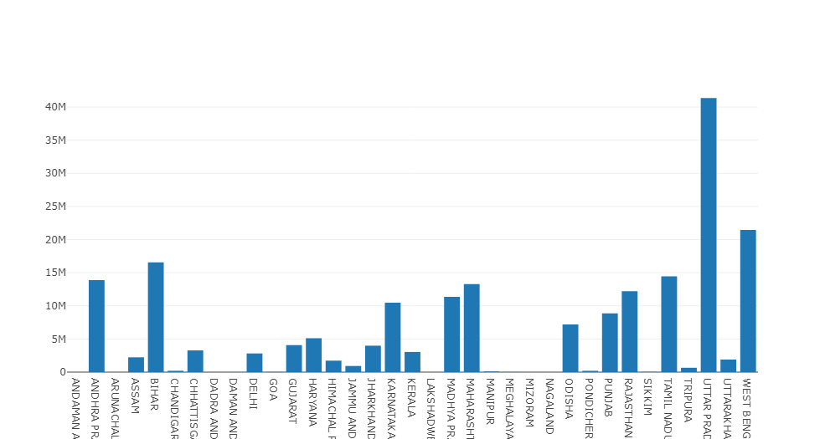
6.(ii) State wise SC populations percentage in India

Slide 14
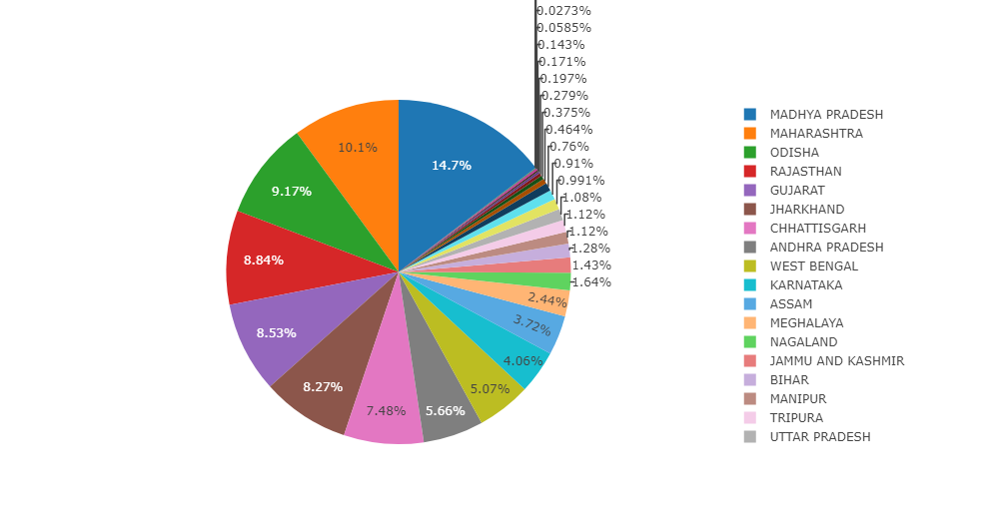
7.(i) State wise ST populations percentage in India

Slide 15
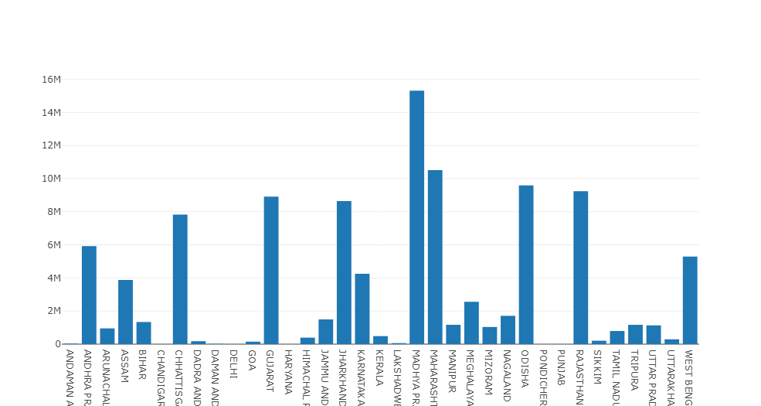
7.(ii) State wise ST populations percentage in India

Slide 16
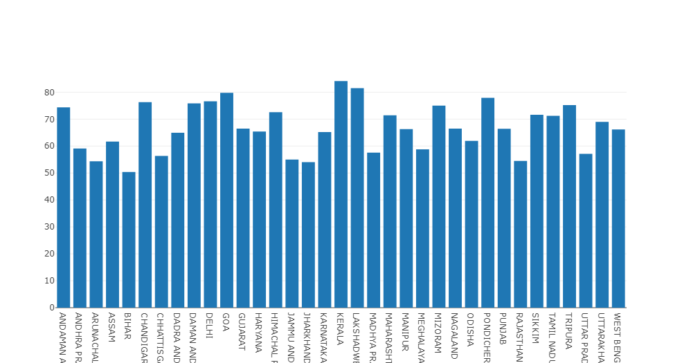
8. Literacy Rate in different states of India

Slide 17
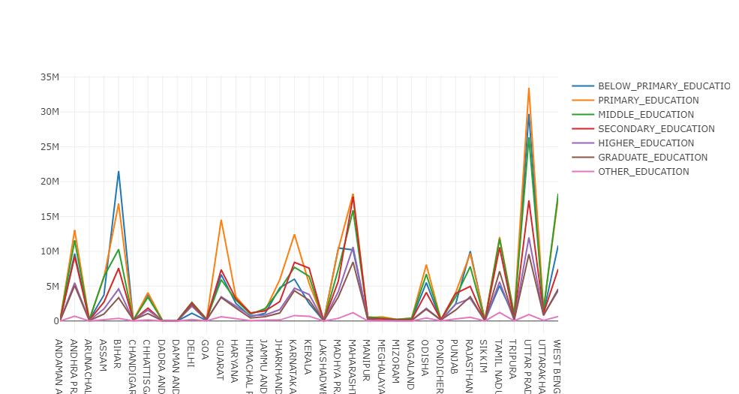
9. Populations of different Types of Workers In Indian states

Slide 18
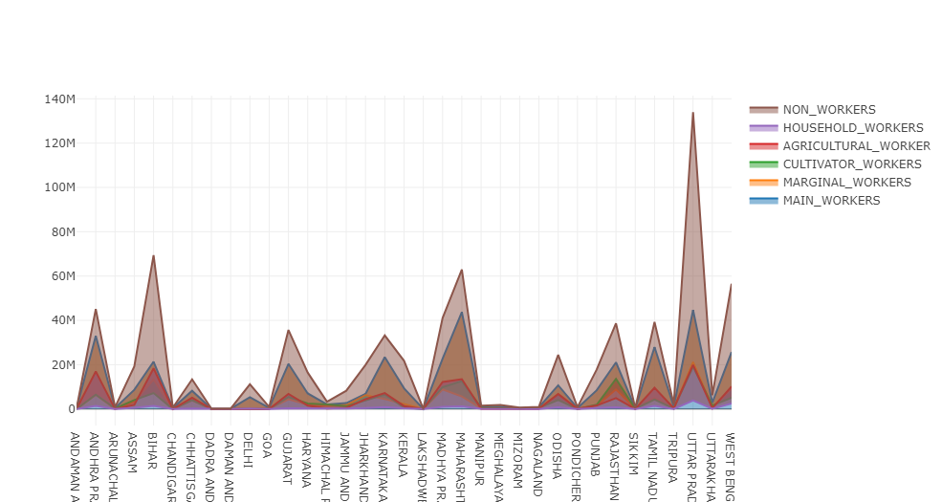
10. Populations of different Types of Workers In Indian states

Slide 19
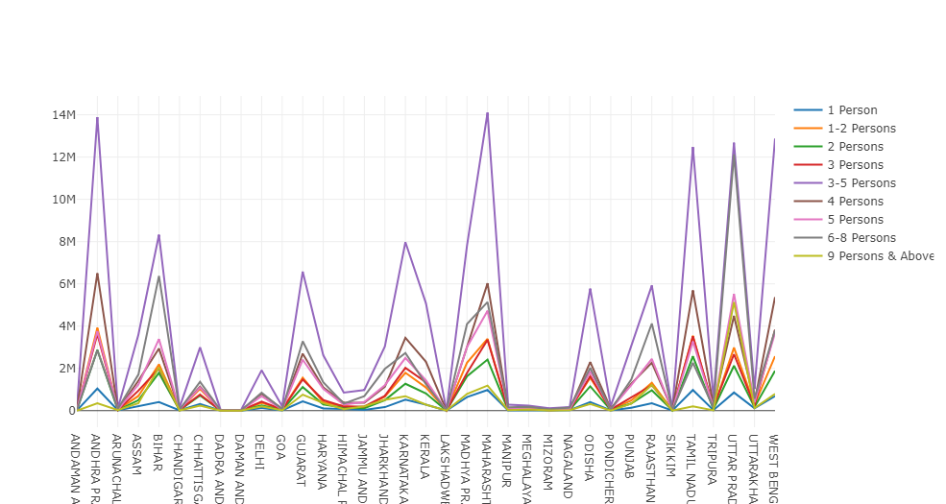
11. State wise house hold size

Slide 20
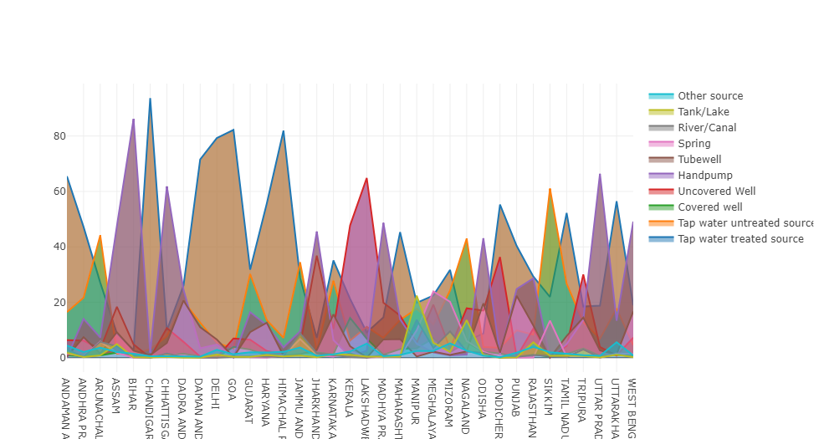
12. State wise population % having different drinking water source

Slide 21
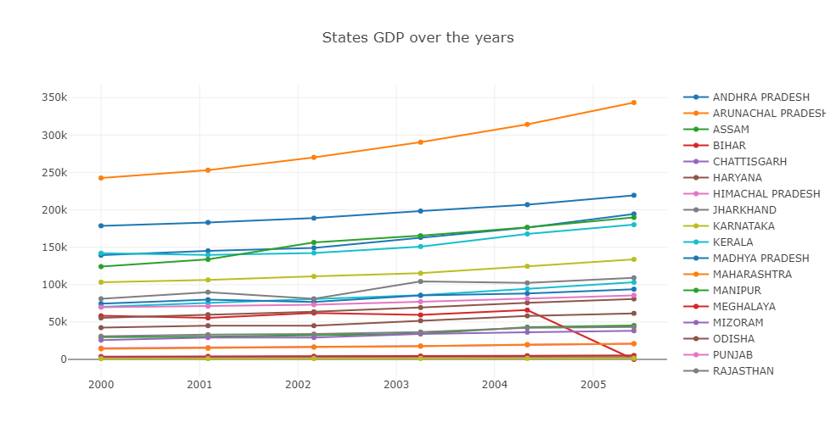
13. State wise Total GDP over the years

Slide 22
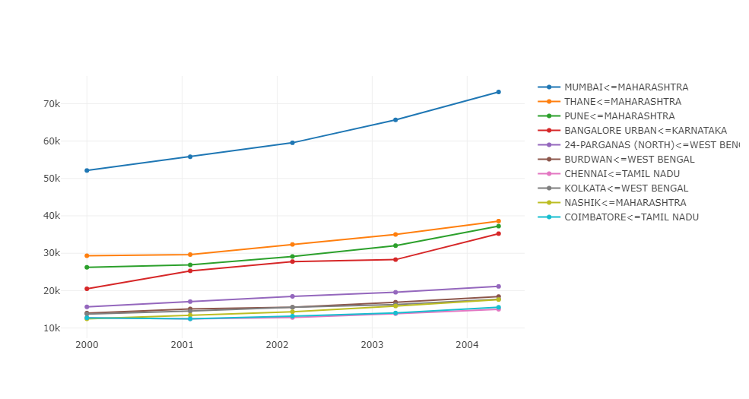
14. constant 10 max GDP over the years [District Level]

Slide 23
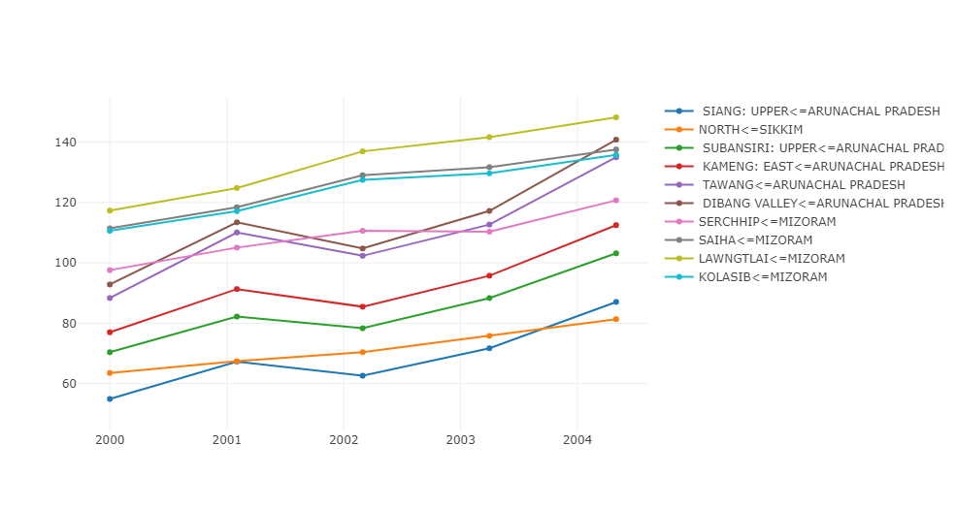
15. constant 10 min GDP over the years [District Level]

Slide 24
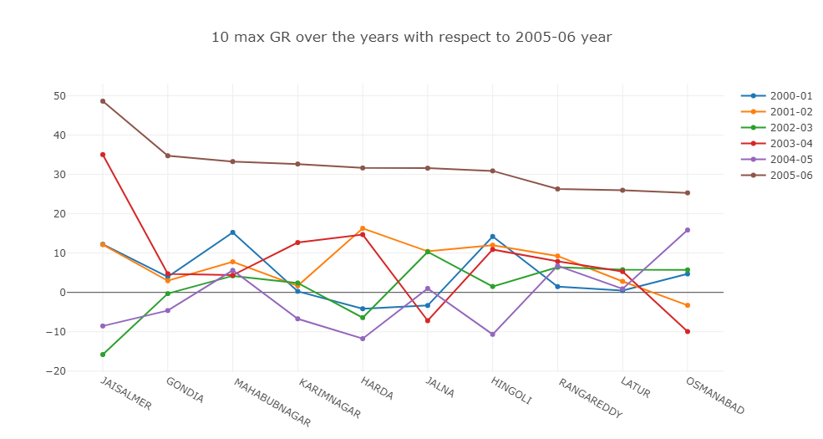
16. constant 10 max GR over the years with respect to '2005-06' [District Level]

Slide 25
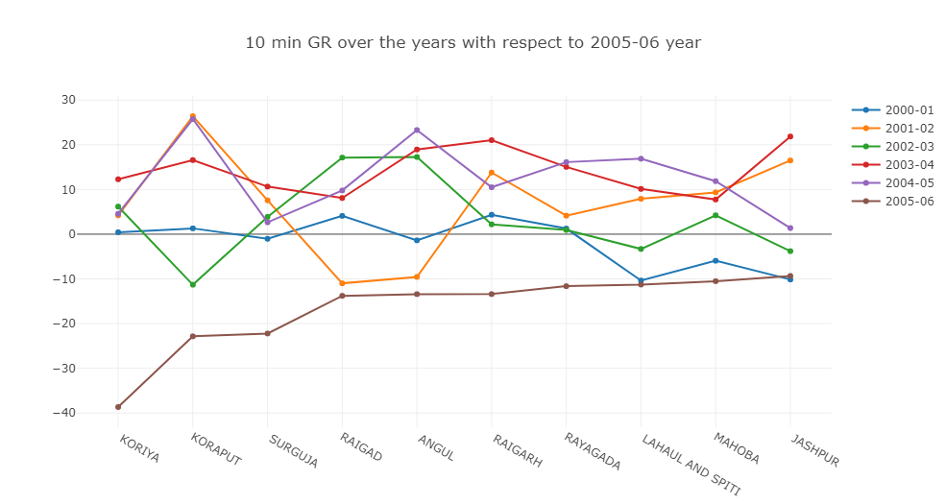
17. constant 10 min GR over the years with respect to '2005-06' [District Level]

Slide 26
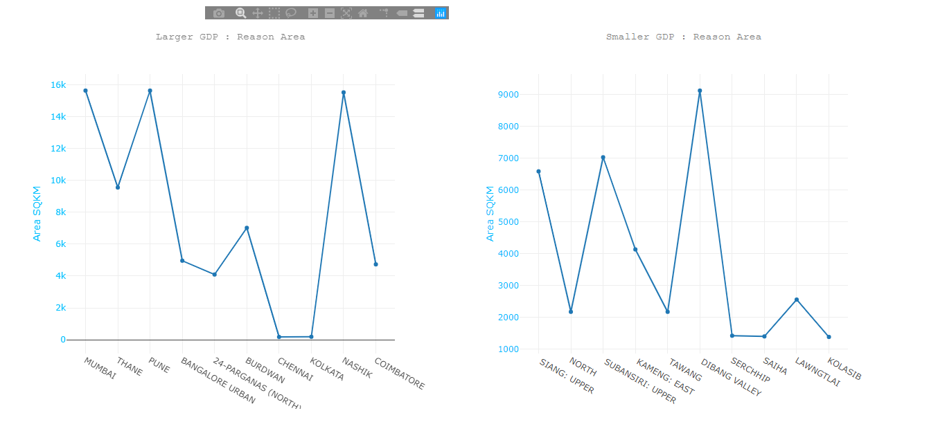
18. Constant 10 max/min GDP over the years, why? a. Area

Slide 27
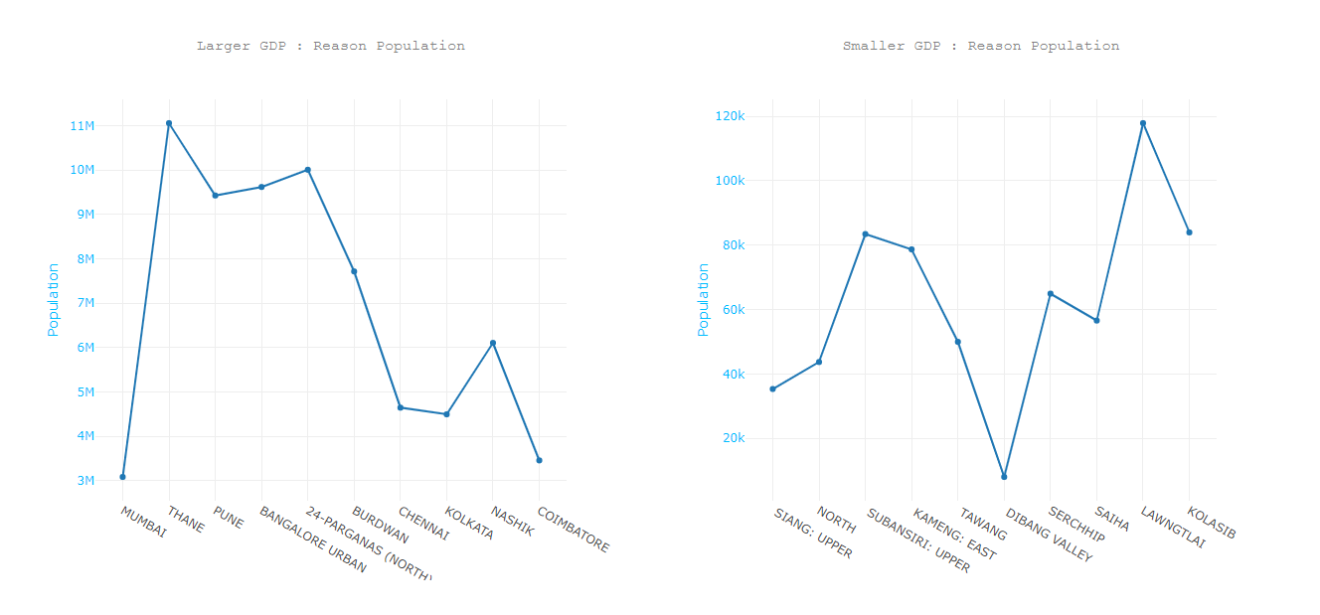
18. Constant 10 max/min GDP over the years, why? b. Population

Slide 28
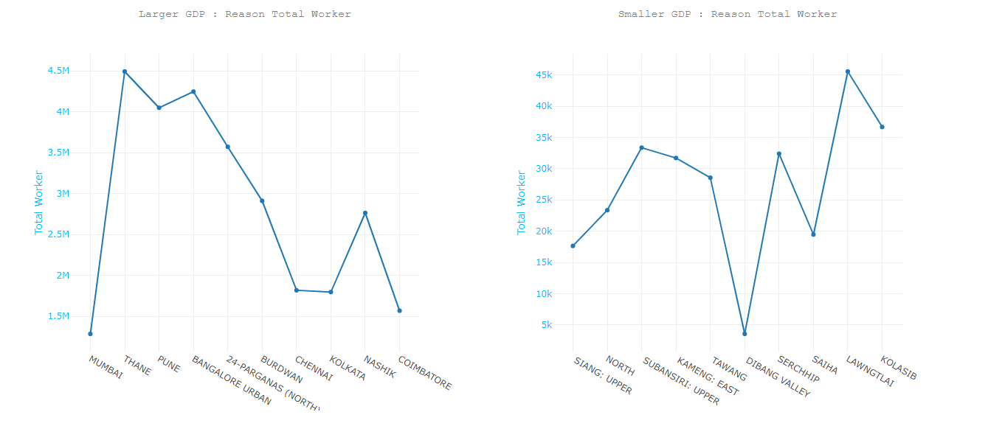
18. Constant 10 max/min GDP over the years, why? c. (i)Total Workers

Slide 29
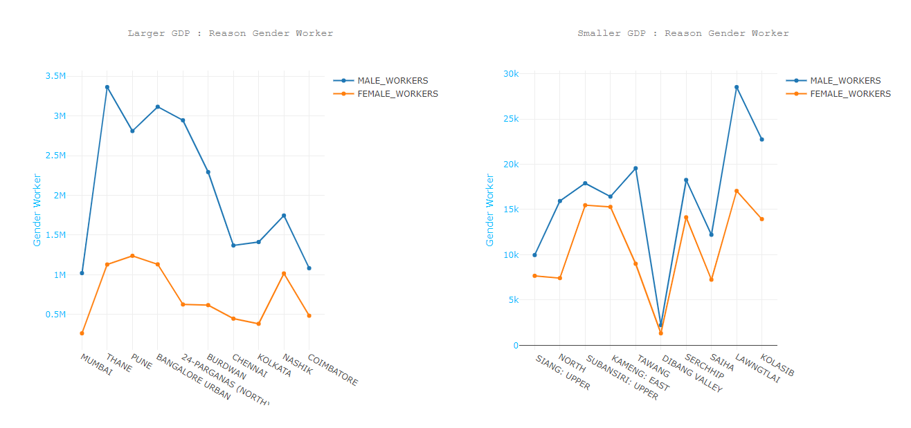
18. Constant 10 max/min GDP over the years, why? c.(ii) Gender Workers

Slide 30
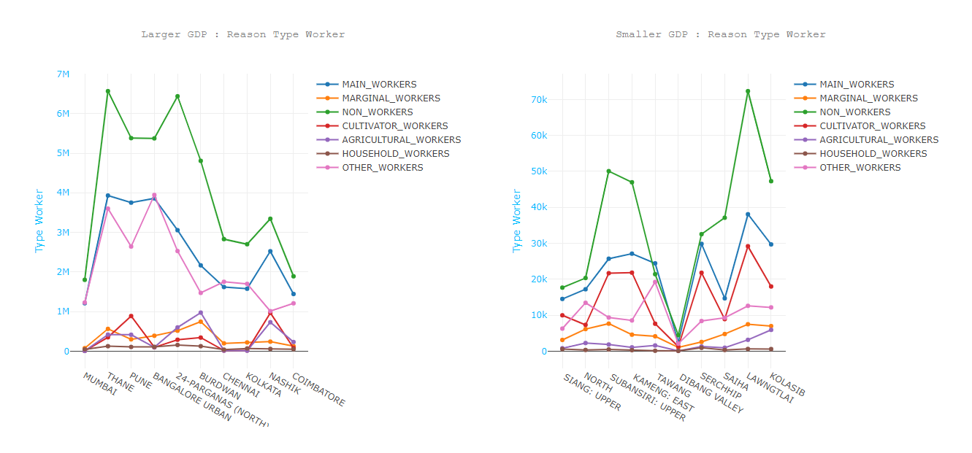
18. Constant 10 max/min GDP over the years, why? c.(iii) Type of Workers

Slide 31
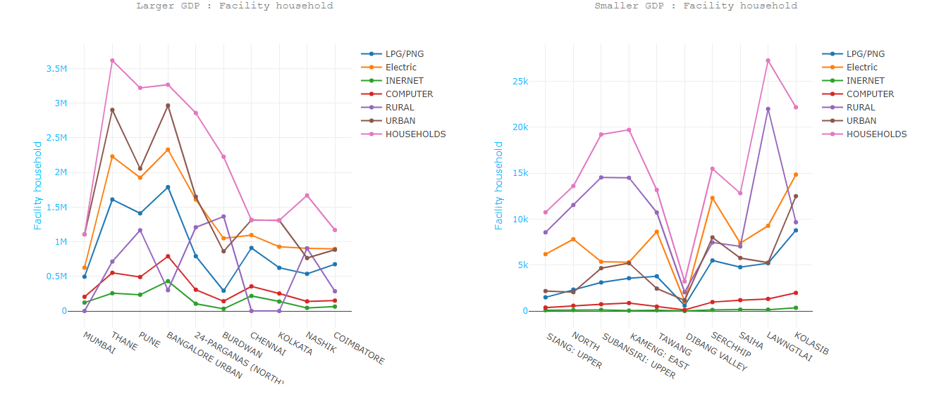
18. Constant 10 max/min GDP over the years, why? d. (i) Facility of household

Slide 32
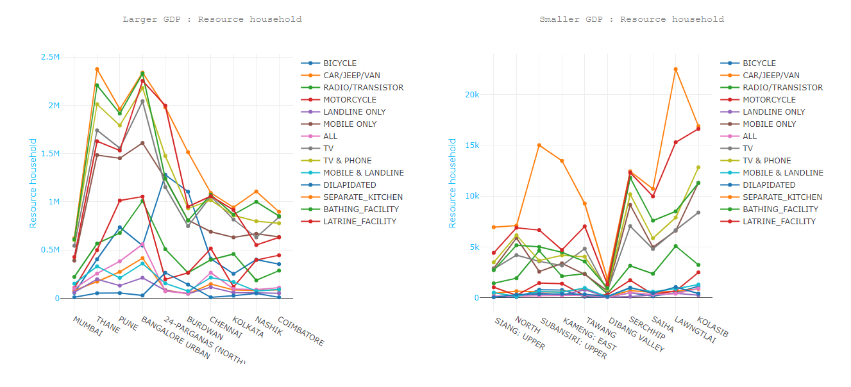
18. Constant 10 max/min GDP over the years, why? d. (ii) Resource of household

Slide 33
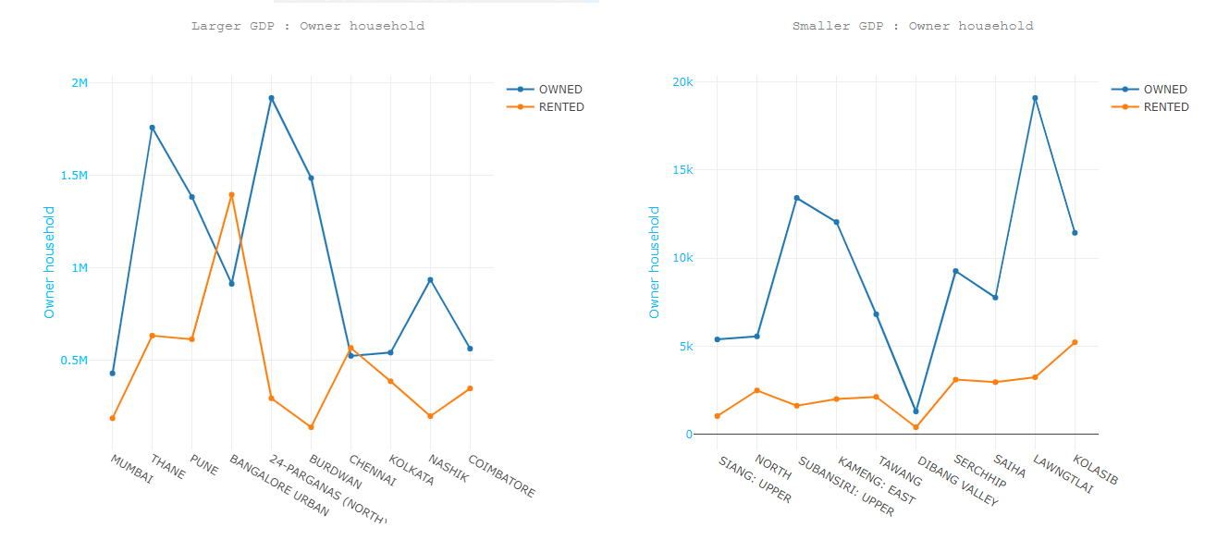
18. Constant 10 max/min GDP over the years, why? d. (iii) ownership of household

Slide 34
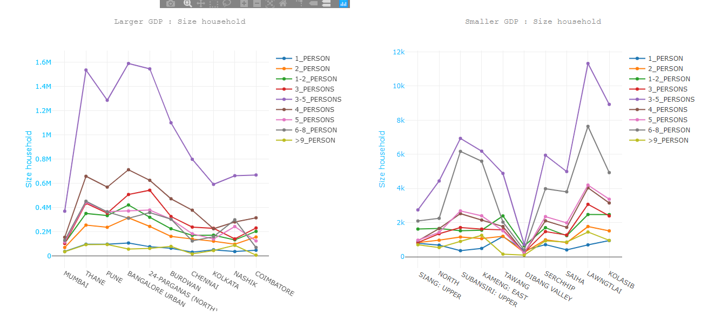
18. Constant 10 max/min GDP over the years, why? d. (iv) size of household

Slide 35
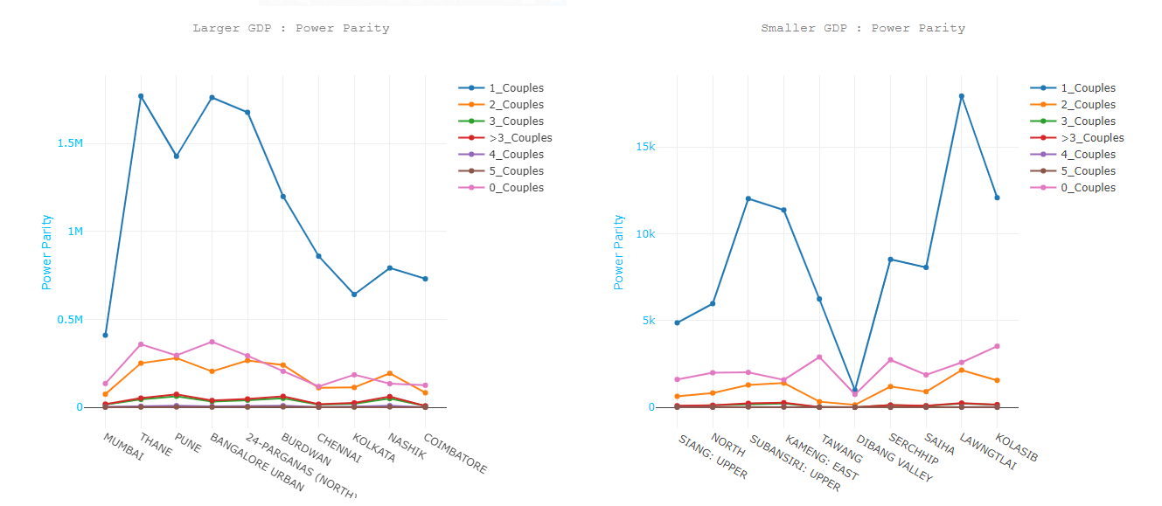
18. Constant 10 max/min GDP over the years, why? d. (v) couple of household

Slide 36
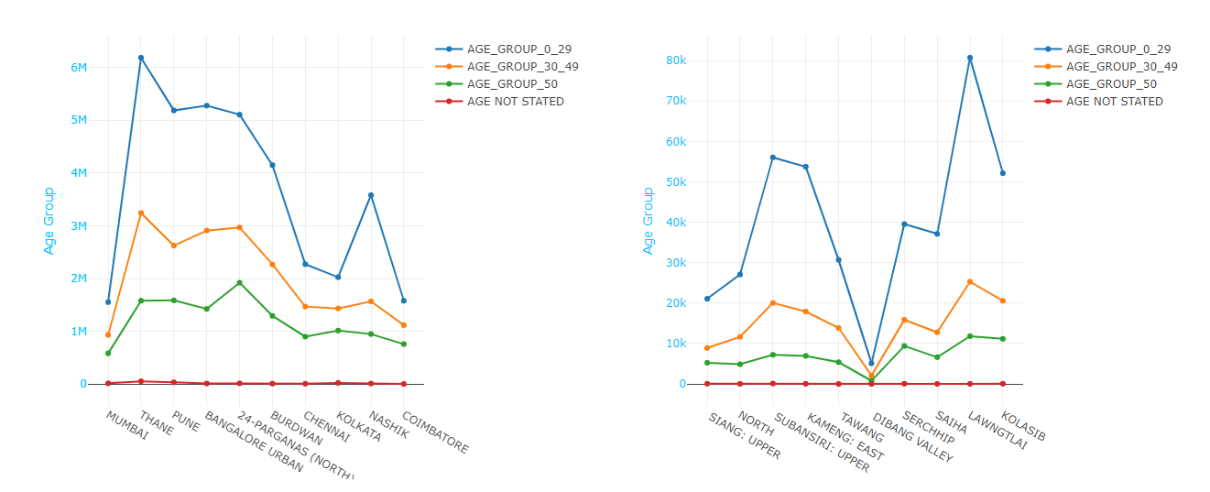
18. Constant 10 max/min GDP over the years, why? e. based on Age Group

Slide 37
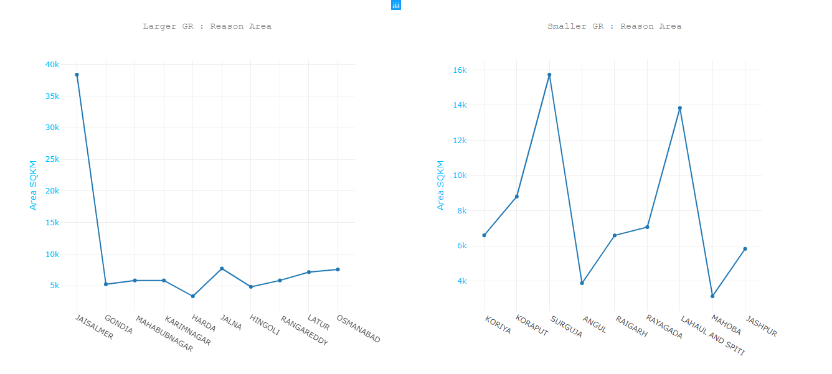
19. Constant 10 max/min GR over the years, why? a. Area

Slide 38
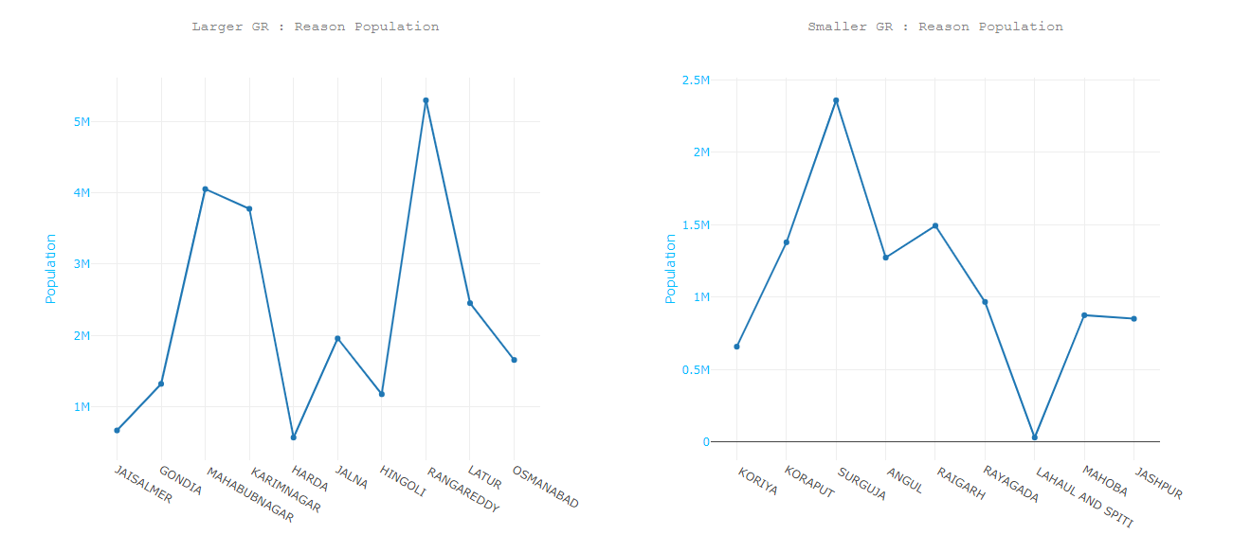
19. Constant 10 max/min GR over the years, why? b. Population

Slide 39
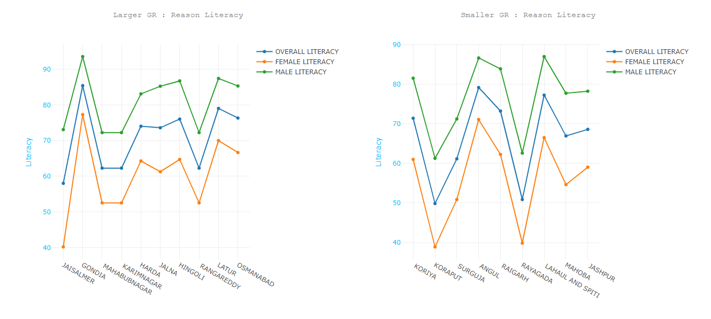
19. Constant 10 max/min GR over the years, why? c. Literacy

Slide 40
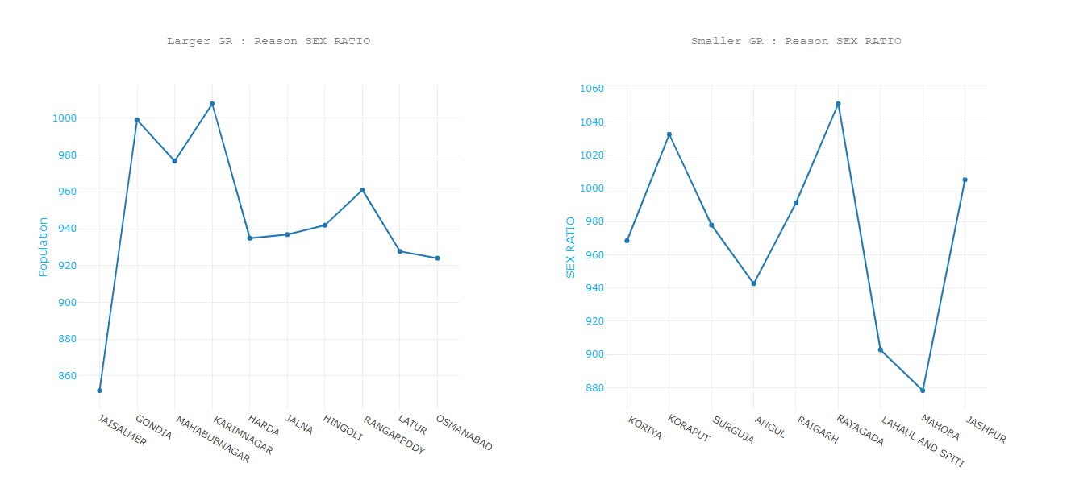
19. Constant 10 max/min GR over the years, why? d. Sex Ratio

Slide 41
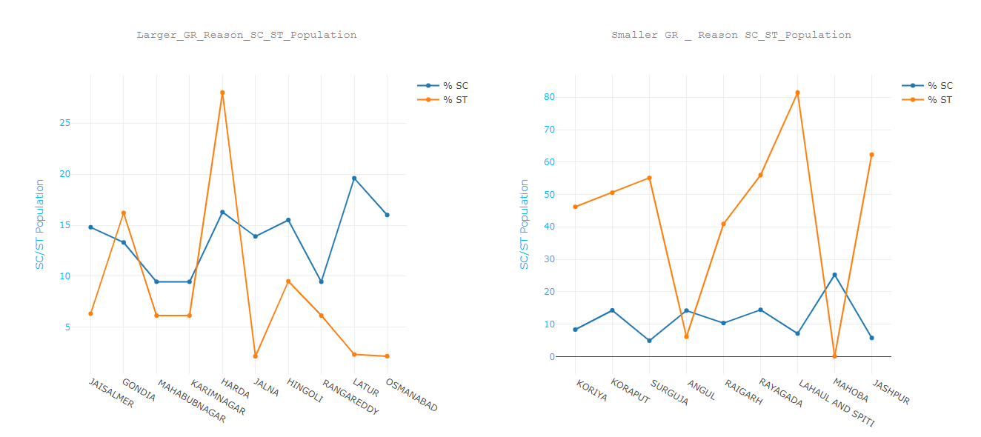
19. Constant 10 max/min GR over the years, why? e. % SC/ST Population

Slide 42
CONCLUSION
With the help of this Analysis we found basic knowledge for Area,Population,Religion,sex ratio ... for the states.
We found the top ten largest & least GDP district and factors behind it.
We found the top ten largest & least GR district and factors behind it.

Slide 43
FUTURE WORKS
Dependency ratio
Maternal mortality
Demographic dividend
Regional Religion - Economic basis comparison

Slide 44
REFERENCES
https://www.kaggle.com/webaccess/all-census-data
https://toolbox.google.com/datasetsearch/search?query=India%20Economic%20Data&docid=zGeYzgrTjJ82YSJSAAAAAA%3D%3D

Slide 45


